Slide 1
DWH Assignment A.A. 2024/2025
Davide Ticchiarelli
Niccolò Ciotti
Giampaolo Marino
Luca Renzi
Riccardo Angelini

Slide 2
Preliminary Overview
Database: The database contains sales data from Northwind Traders, a fictitious company specializing in food import-export.
Goal: Analysis of orders based on time, employees, customer (also geographical area) and product.
Measures:
Calculation of average revenue
Calculation of total number of orders
Determination of products sold by order
Calculation of average delivery time

Slide 3
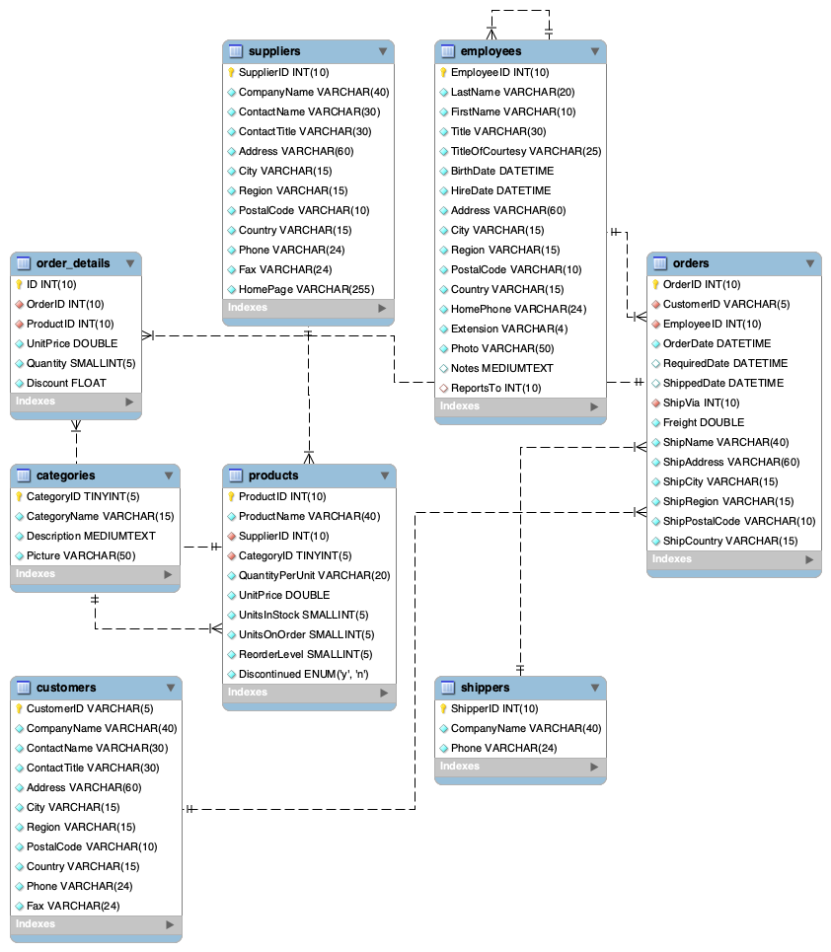
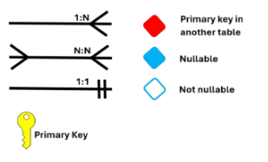
Reverse engineering
The ER model was generated through the following steps:
Analysis of the SQL file and generation of the ER schema by reverse engineering
Identification of entities and relationships
Primary and foreign key recognition
Construction of the E-R model

Slide 4
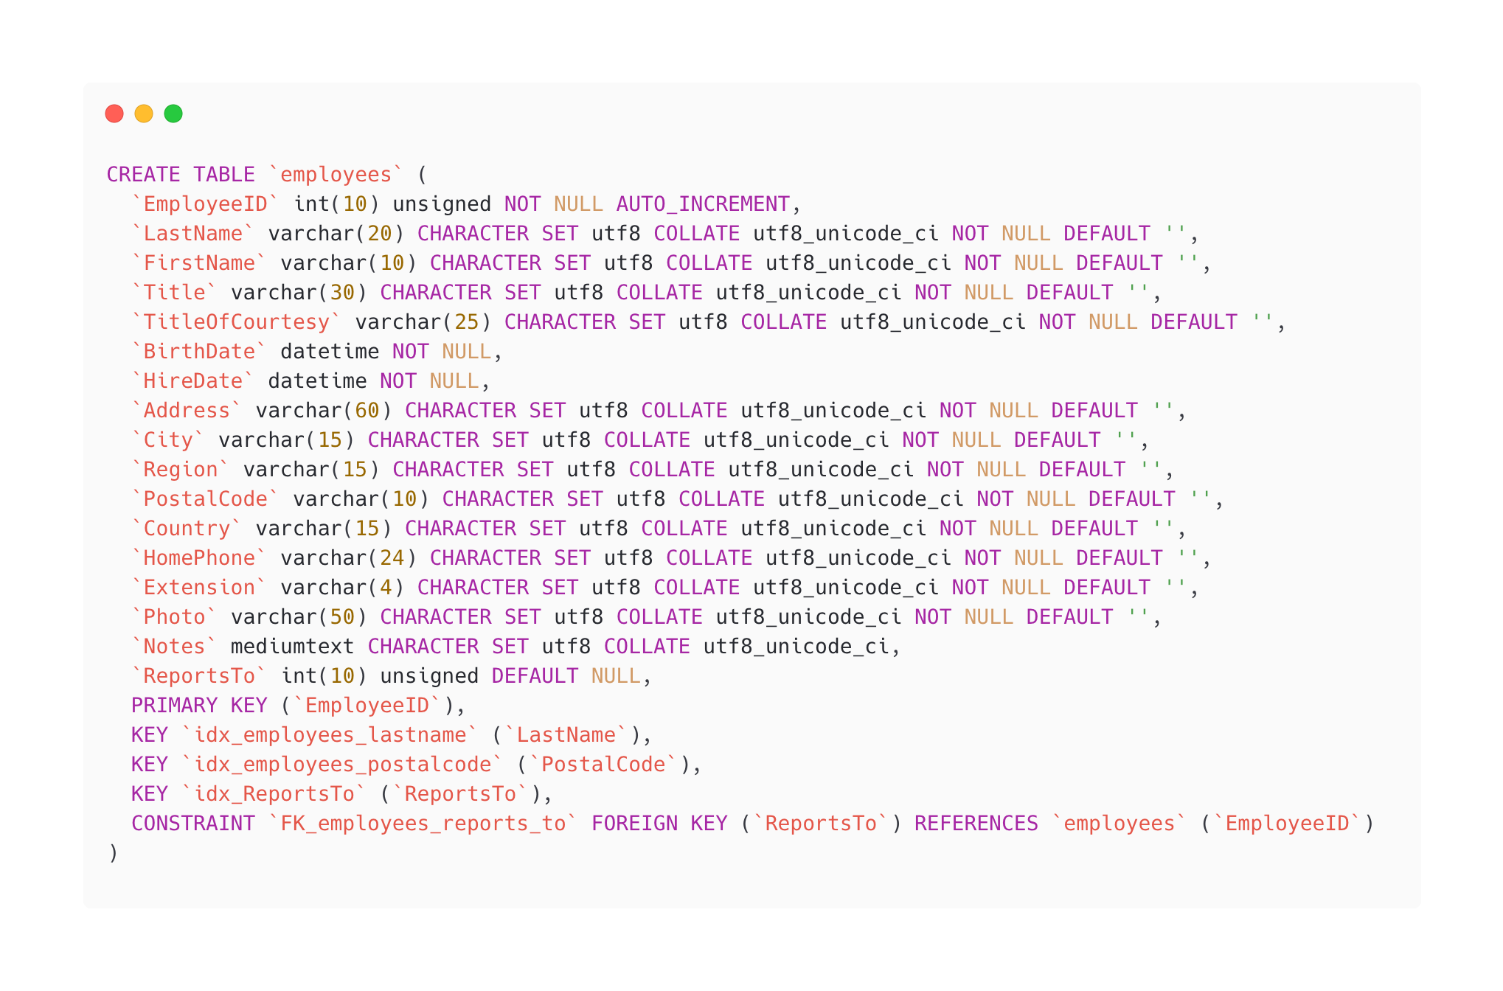
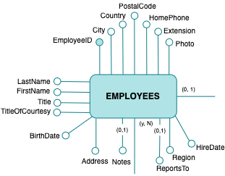
Optional attributes- Example

Slide 5
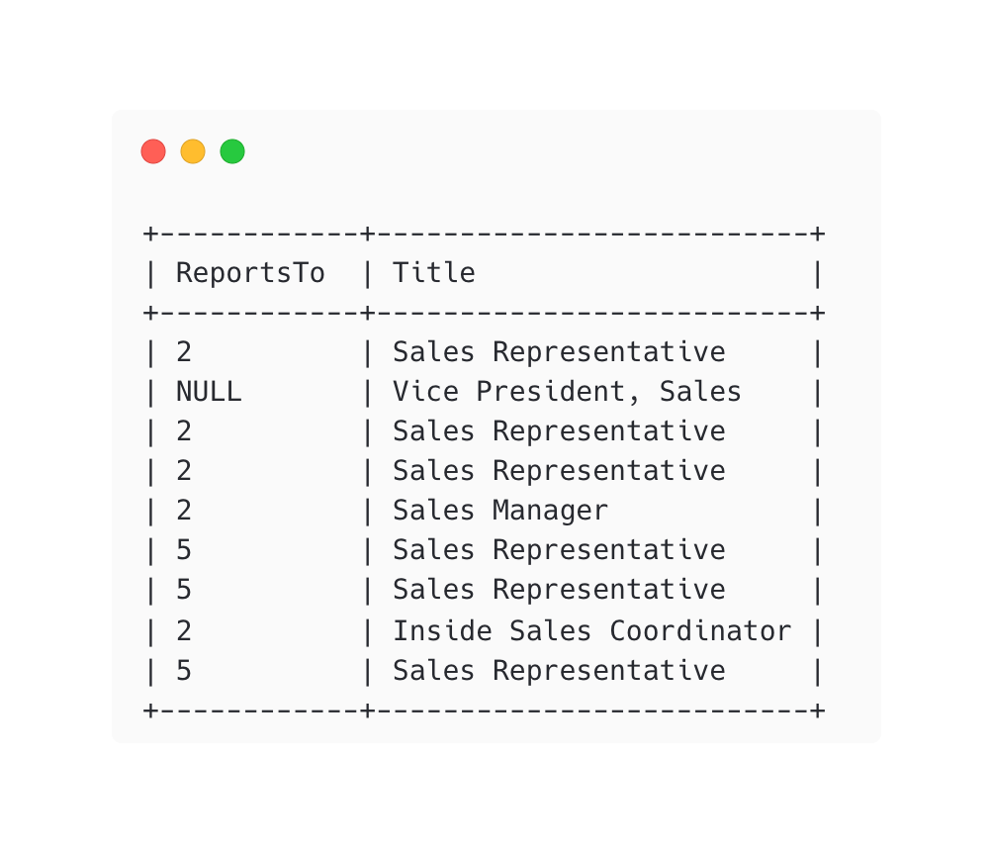
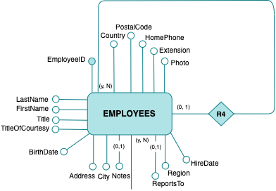
Cyclical relationship
The R4 relationship has been transformed into a specific sequence of relationships, explaining their different levels. In particular, the following entities were created based on the above result: EMPLOYEES, MANAGER and CHIEF

Slide 6
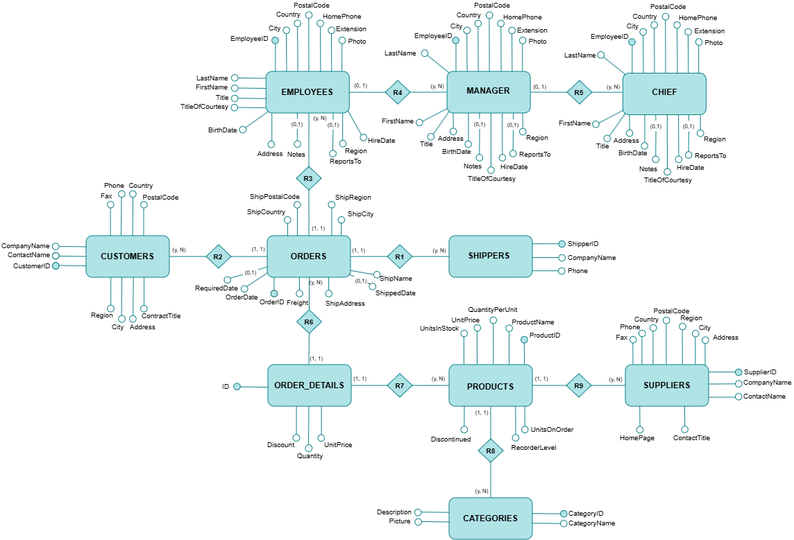
Final ER model

Slide 7
Attributes tree
Starting from the ER model, the tree was generated by the following procedure:
Identification of the fact: creation of the root node of the tree from its primary key. In our case, we used "ORDER_DETAILS" as a fact of the attribute tree to analyze orders
Definition of attributes
Iterative tree extension
​

Slide 8
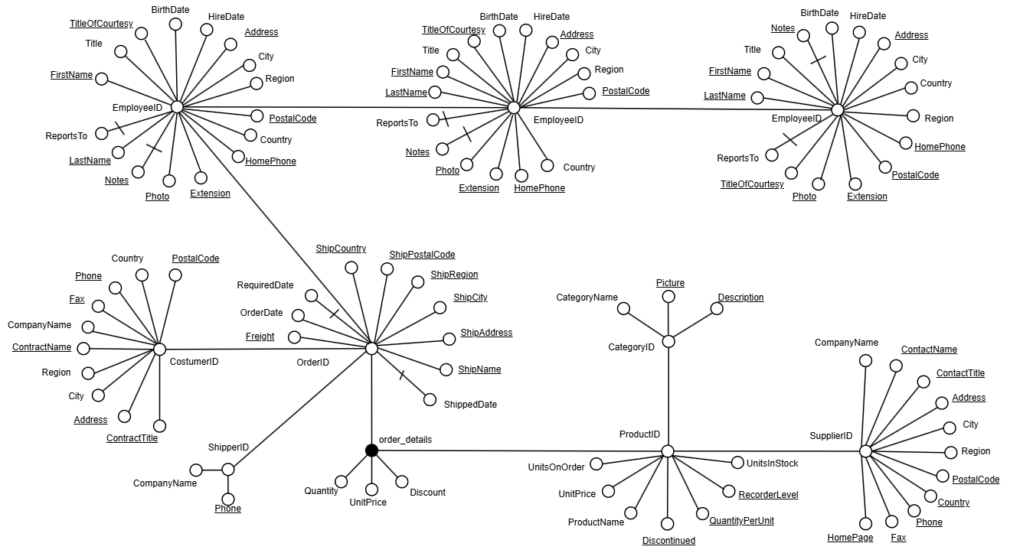
Attributes tree

Slide 9
Refinement of the tree
In the following list we have reported all the operations performed to reduce the attribute tree:
All elements considered irrelevant for the analysis have been eliminated. For example, nodes related to MANAGER, CHIEF, SHIPPERS and SUPPLIERS, as well as some attributes of PRODUCTS, CUSTOMERS, CATEGORIES, ORDERS and EMPLOYEES
The CategoryName node has been grafted to CategoryID
Functional dependencies have been eliminated:
OrderID -> CustomersID
OrderID -> EmployeesID
OrderID -> OrderDate
OrderID -> ShippedDate
The BirthDate and OrderDate nodes have been reified to clarify their hierarchy

Slide 10
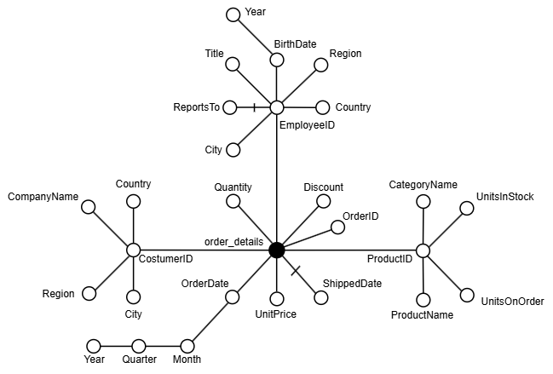
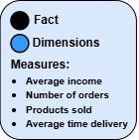
Refined attributes tree

Slide 11
Measures analysis
Average income: avg(sum(order_details.UnitPrice * order_details.Quantity * (1 - order_details.Discount)))
Number of orders: count(order_details.OrderID)
Products sold by order: sum(order_details.Quantity)
Average delivery time : avg(datediff(order_details.ShippedDate, order_details.OrderDate))
 | Product |  | Customer |  | Employee |  | Time
 | Add. | Aggr. Op. | Add. | Aggr. Op. | Add. | Aggr. Op. | Add. | Aggr. Op.
Average income | No | Algebraic | No | Algebraic | No | Algebraic | No | Algebraic
Number of orders | No | Distributive | No | Distributive | No | Distributive | No | Distributive
Products sold by orders | Yes | Distributive | Yes | Distributive | Yes | Distributive | Yes | Distributive
Average time delivery | No | Algebraic | No | Algebraic | No | Algebraic | No | Algebraic

Slide 12
Thanks for your attention

